Slide 1
AI-Powered RAG System
Cybercrime Investigation Assistant for Detectives
Retrieves relevant case evidence, ranks it with confidence, and generates a cited investigation report without hardcoding case facts.
Core principle
Design goal
Risk handled
Evidence first. LLM second. Citations always.
Reusable across future case corpora.
Red herrings and prompt injection.
Case Evidence Retrieval System | RAG System Design

Slide 2
Problem Framing
Detectives have 8 case files, but not all are relevant.
Need natural-language investigation questions.
Need evidence retrieval, ranking, justification, and report generation.
Prompts must remain case-agnostic
What the system should do
Turn a detective question into ranked evidence and a cited report.
What it should not do
Let the LLM invent facts from memory or hidden case-specific prompts.
Case Evidence Retrieval System | RAG System Design

Slide 3
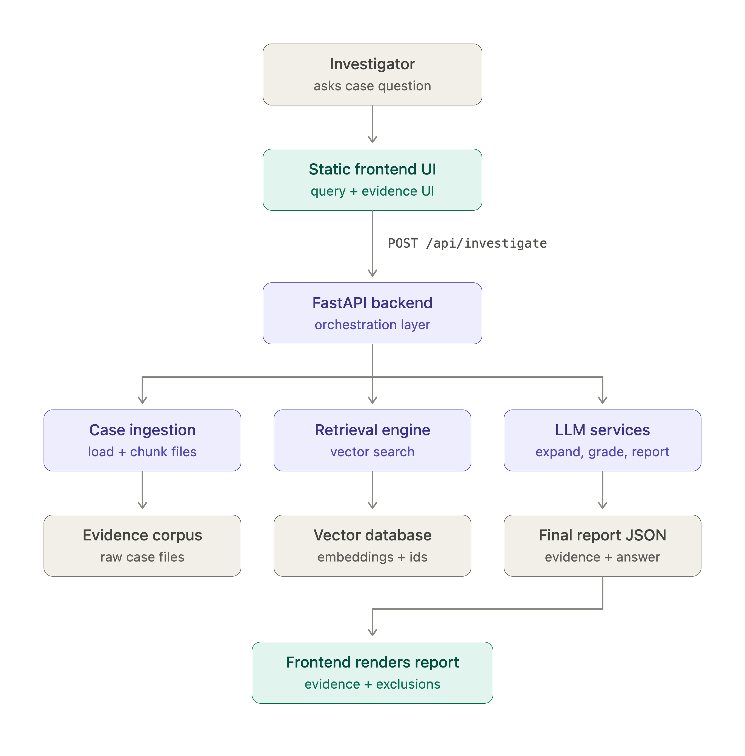
High level architecture
Case Evidence Retrieval System | RAG System Design

Slide 4
Model And Database Choices
Embedding model
Chat model
Vector DB
text-embedding-3-small Fast, cost-effective, and strong enough for short evidence files. Whole-document embedding preserves red-herring context.
gpt-4o-mini Used for query expansion, relevance grading, and report generation. Good quality/cost balance for interactive use.
ChromaDB Simple persistent local vector store with cosine similarity. Suitable for a small case-file corpus.
Case Evidence Retrieval System | RAG System Design

Slide 5
Retrieval Strategy: Single vs Multi-Step
Goal: broader evidence coverage with cleaner final context
Single-step
Multi-step
One query
One vector search
Nearest evidence only
Risk: misses multi-doc evidence
Expand query
Search multiple angles
Merge + deduplicate
Rank + LLM-grade
Chosen strategy-> Multi-Step Retrieval

Slide 6
Ranking, Confidence, And Explainability
confidence = 1 - cosine_distance
Each result shows
Excluded docs
Important caveat
Source file Confidence score Matched query Relevance reason Evidence text
Not hidden
Shown separately with why they were ruled out.
Confidence is retrieval similarity, not probability of truth
Case Evidence Retrieval System | RAG System Design

Slide 7
Evaluation And Verification
Stored fixture result
Offline mock check
Honest caveat
100% retrieval recall ~86% distractor rejection 8/8 top-1 relevant 0 hallucinated source citations
No OpenAI calls Checks retrieval wiring Checks confidence conversion Checks citation retry
100% is fixture-level only. It is not a real-world accuracy claim.
Case Evidence Retrieval System | RAG System Design

Slide 8
Final Positioning
Designed evidence-based assistant for helping detectives
Traceable
Reusable
Robust
Evidence + citations before conclusions.
No case-specific facts in prompts.
Designed for red herrings and prompt injection.
Case Evidence Retrieval System | RAG System Design

Slide 9
Scope for Improvement & Learnings
What I would improve next, and what the assessment taught me
Scope for Improvement
Key Learnings
1
Larger evaluation set
1
Recall matters in investigations
More queries, more files, harder multi-doc and adversarial cases.
Missing evidence is risky than one extra doc.
2
Citation-level grounding
2
Similarity is not relevance
Map every report claim back to a source snippet.
High cosine score can still be a red herring.
3
Robustness checks
3
Multi-step adds control
Prompt injection, red herrings, and hallucination detection.
Expansion + grading improves coverage and context quality.

Slide 10
Scaling Next Steps
If moved beyond the assessment into production
1. Robust Ingestion
2. Retrieval Infrastructure
3. Performance
Incremental updates
Validation + dedup
Document versioning
Production vector DB
Better indexing
Threshold tuning
Caching
Batching
Async processing
4. Observability
5. Continuous Evaluation
Latency + token cost
Retrieved / excluded docs
Failure analysis
Larger test set
Harder edge cases
Regression checks
Focus: make ingestion reliable, retrieval scalable, and evaluation repeatable

